Slide 1
Vehicle plate Recognition
Xiang Gao
Yuanyuan Wu

Slide 2
Introduction
The purpose of this project is to identify a plate from a car photo and translate it to characters into a text file.
Main steps: plate locate, character extract, character match

Slide 3
Introduction
Basic environment: We are using Python2.7, tesseract 3.05.00 and Opencv3.1.0
Main method

Slide 4
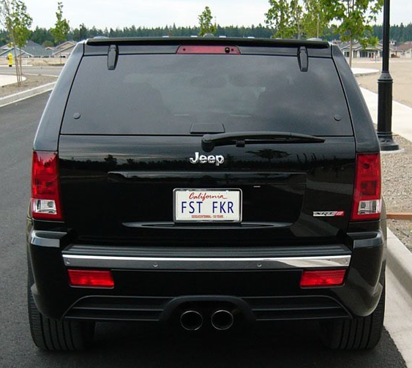
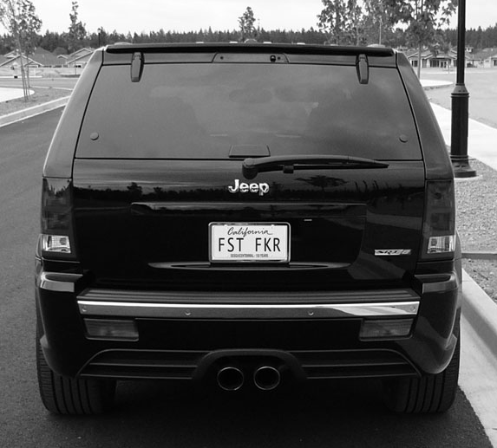
Pre-Processing
Grayscale
A three-channel RGB color image into a single channel
img = cv2.imread(filename, 0) # import a image
gray = cv2.cvtColor(im,cv2.COLOR_BGR2GRAY) # create a grayscale version

Slide 5


Locate plate
Vertical Edge Detection:
The characters on the plate have sharp edges, while they are mainly vertical. Therefore, a large amount of useless information on the image can be removed by vertical edge detection.
1st, using Sobel detection in the x direction
x = cv2.Sobel(img, cv2.CV_16S, 2, 0)
Plate Area

Slide 6
Locate plate
Vertical Edge Detection:
2nd, Converts the image format back to 8-bit depth for further processing
dst = cv2.convertScaleAbs(x, 0, 0.00390625)

Slide 7
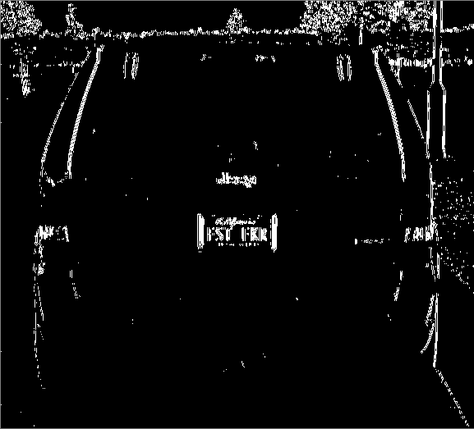
Locate plate
Adaptive Binarization Processing
ret, temp = cv2.threshold(dst, 0, 255, cv2.THRESH_OTSU)

Slide 8
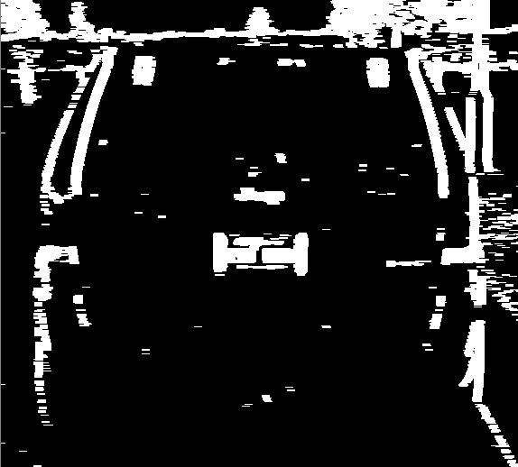
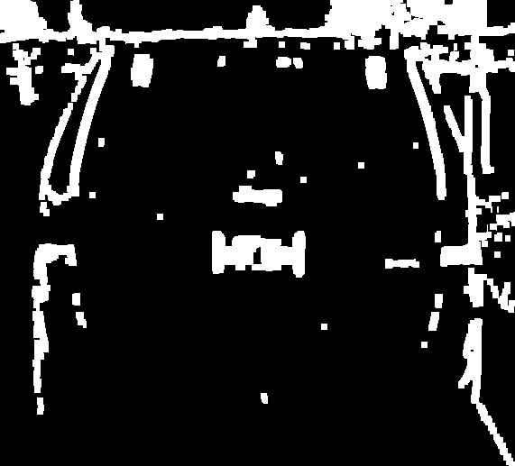
Locate plate
Dilation and Erosion :
1st, create a square in the x direction
square = cv2.getStructuringElement(cv2.MORPH_RECT, (3, 1))
Array([1, 1, 1])
2nd, dilation, expansion of connected
temp = cv2.dilate(temp, square, iterations=4)
3rd, erosion, removal of debris
temp = cv2.erode(temp, square, iterations=4)
4th, do it again in the y direction
square = cv2.getStructuringElement(cv2.MORPH_RECT, (1, 3))
Array([[1],
[1],
[1]])

Slide 9
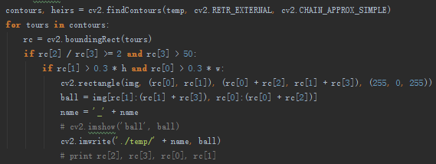
Locate plate
Selecting from candidate areas
We devised some algorithms to filter the plate
The plate width is more than twice the height
The plate location

Slide 10
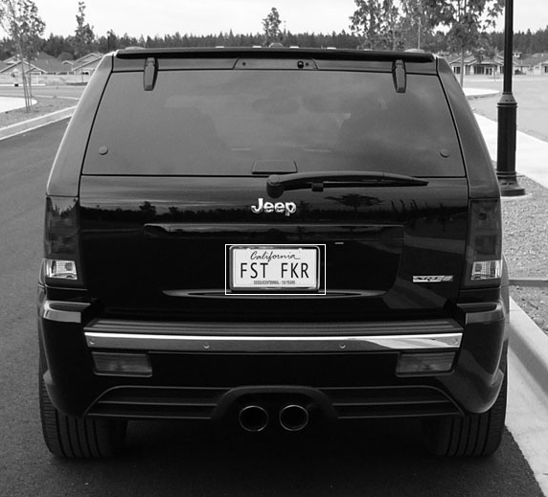
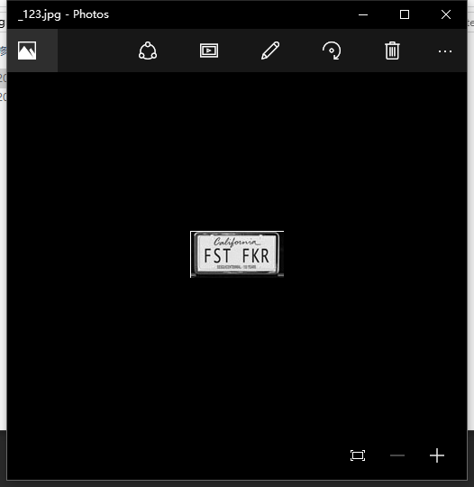
Extract character
Morphological Treatment:
Mark plate and Extract it from the image.

Slide 11
Extract character
Extract Characters from Plate:
1st, we need to remove the border
Performs a progressive cutting in the Y direction, then X direction
2nd, filtration of the candidate characters.

Slide 12
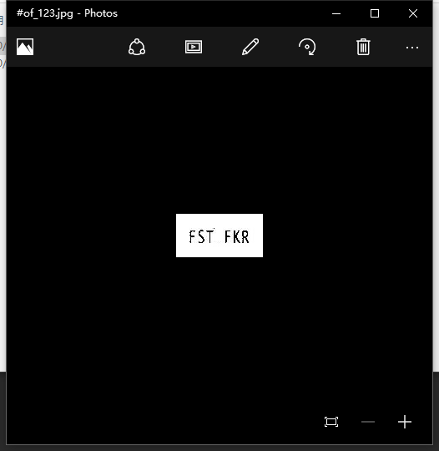
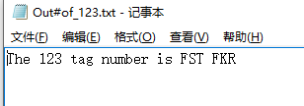
Match characters
Using tesseract to match characters.
Tesseract has unicode (UTF-8) support, and can recognize more than 100 languages "out of the box". It can be trained to recognize other languages.

Slide 13
MATCH CHARACTERS
Train model
we have to train every word and some find of fonts as images.
Extract words
cut out each word from plate as images
Match
Match each word pic and models, then output character.

Slide 14
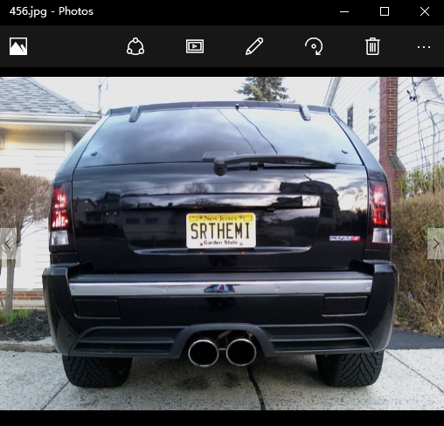
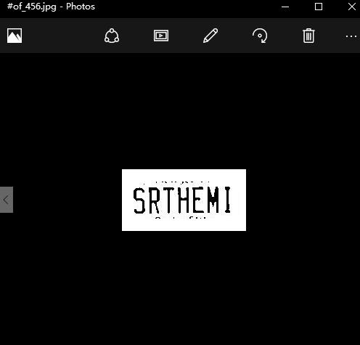
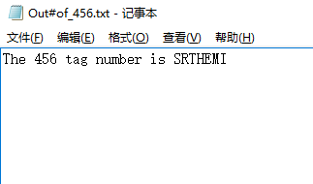
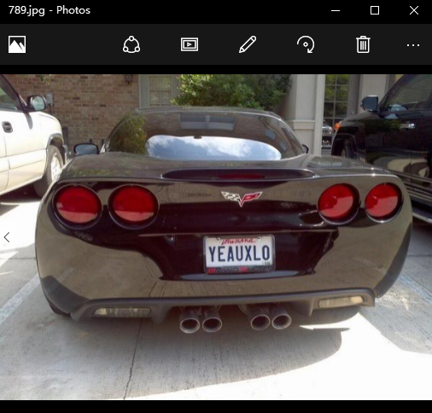
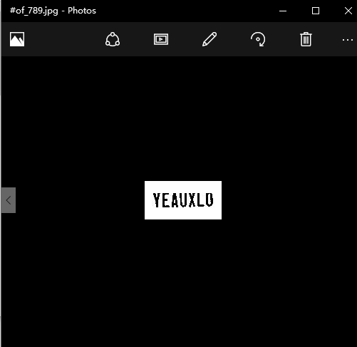
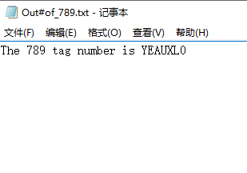
Other examples

Slide 15
Thanks for listening!
Xiang Gao
Yuanyuan Wu

